Slide 1
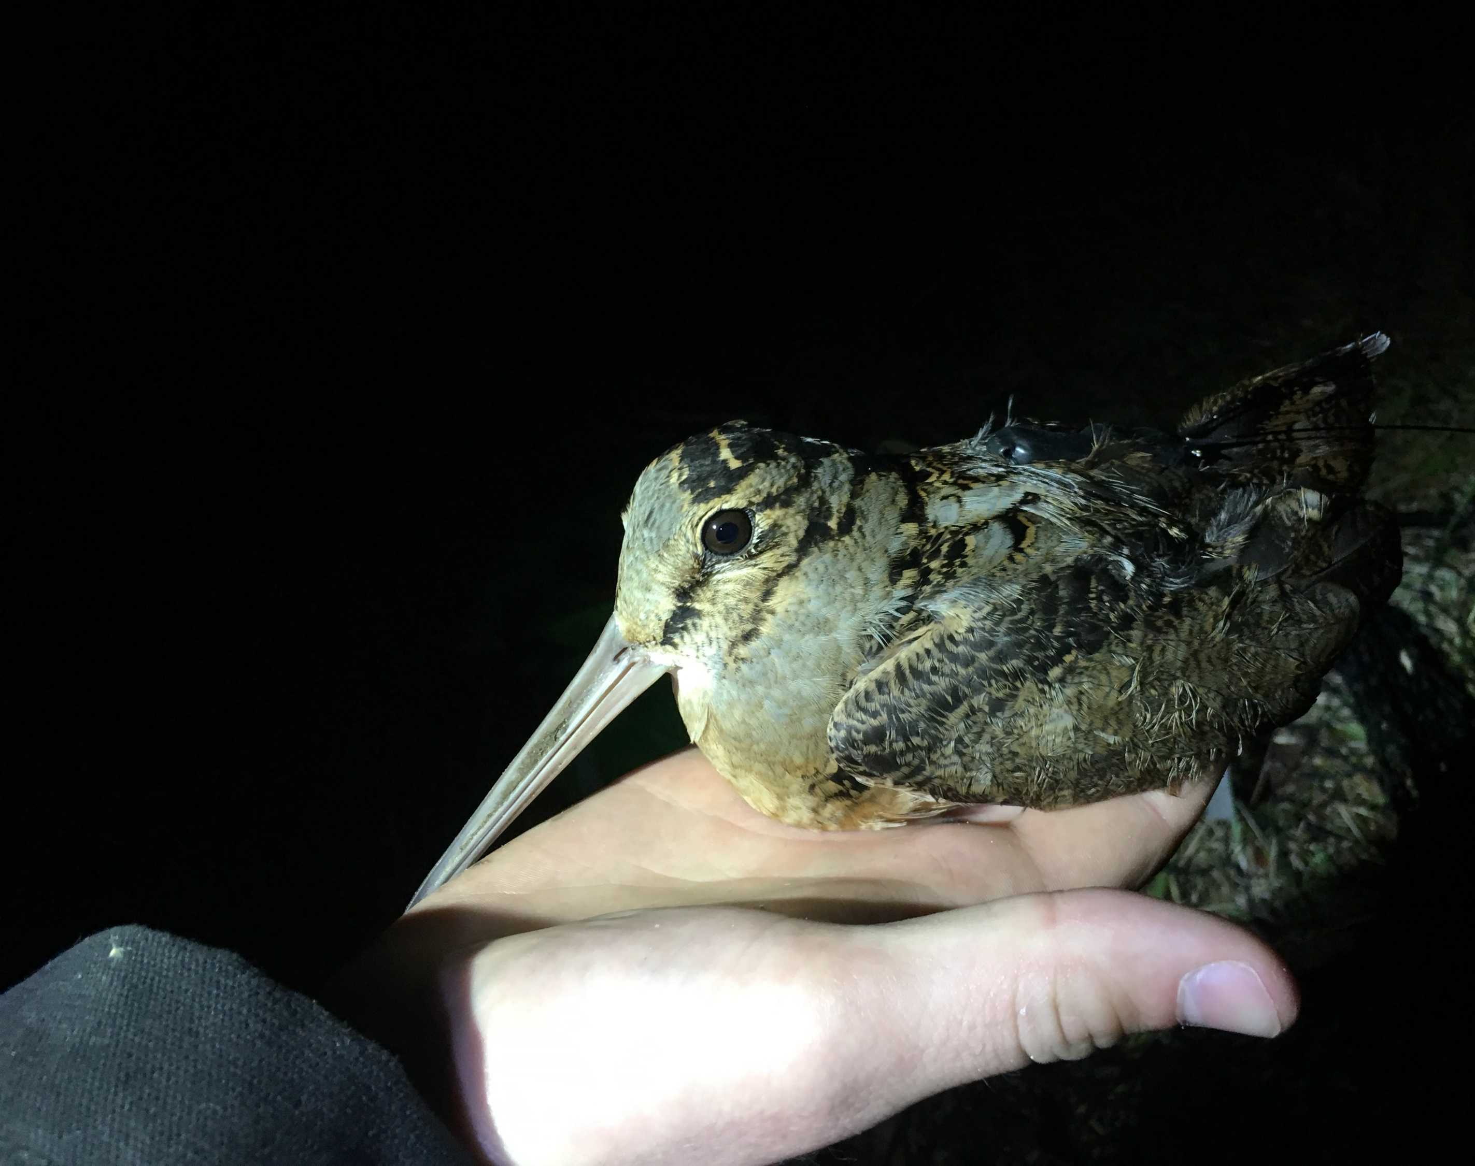
Woodcock Habitat Modeling
Fourth quarterly update, 7/7/2021
Liam Berigan

Slide 2
Review of initial interests
“Differences between breeding and stopover habitat”
“Migratory connectivity through Pennsylvania”
“Managing for resilient gamelands”
“Is urban light pollution affecting stopovers?”

Slide 3
Changes to the models since last meeting
New variables
500m and 10km landscape metrics
Succession class (LANDFIRE derived), ecoregions
New data
Migratory: Spring 2021 stopover locations
Residential: State woodcock surveys
New method for variable selection
Incorporate parsimony into the models
Evaluate variable importance
Incorporation into a Shiny app

Slide 4
Evaluating habitat models
AUC is:
A method for evaluating the accuracy of a predictive model
The probability of correctly ranking a used/available pair
0.0 AUC
Always wrong
0.5 AUC
“Coin flip”
1.0 AUC
Always right
0.6 – 0.75
Good model
0.75 – 0.95
Excellent model

Slide 5
Evaluating the migratory model
0.78
Final migratory model
0.0 AUC
Always wrong
0.5 AUC
“Coin flip”
1.0 AUC
Always right
0.6 – 0.75
Good model
0.75 – 0.95
Excellent model

Slide 6
Evaluating the residential model
0.68
Q3 residential model
0.83
Final residential model
0.0 AUC
Always wrong
0.5 AUC
“Coin flip”
1.0 AUC
Always right
0.6 – 0.75
Good model
0.75 – 0.95
Excellent model

Slide 7
Migratory model
Suite | Full (0.78 AUC) | Relevance (same values) | Importance (0.64 AUC) | Parsimony (no AUC)
Landscape (500m) | AI, Cohesion, ED, % Forest, % Agri, % Dev | → | Cohesion, % Forest | % Forest
Landscape (1km) | AI, Cohesion, ED, % Forest, % Agri, % Dev | → | Cohesion, % Forest
Landscape (5km) | AI, Cohesion, ED, % Forest, % Agri, % Dev | → | Cohesion, % Forest
Landscape (10km) | AI, Cohesion, ED, % Forest, % Agri, % Dev | →
Land Cover | Forest, Successional Class | →
Geography | Elevation, Slope, Ecoregions | →
Moisture | Drainage, TWI | →
Notes:
Threshold step: remove variables with almost no relevance to the response
Interpretation step: all variables which are important to the response, allowing for redundancy
Prediction step: Redundancy removed

Slide 8
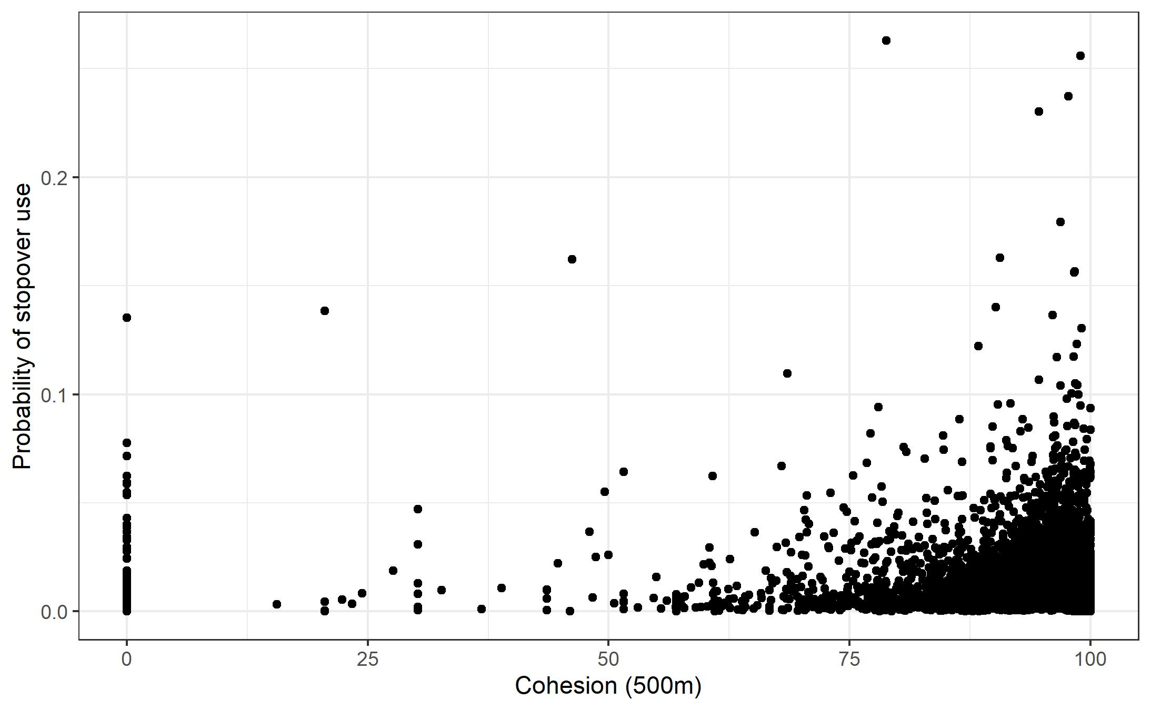
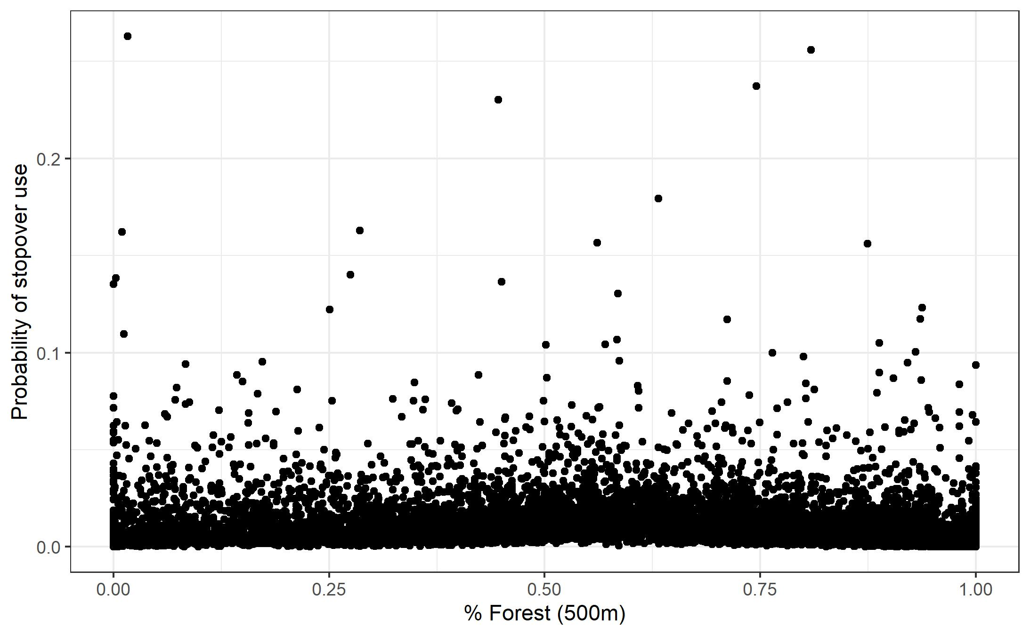

Slide 9
Residential model
Suite | Full (0.82 AUC) | Relevance (same values) | Importance (0.83 AUC) | Parsimony (0.81 AUC)
Landscape (500m) | AI, Cohesion, ED, % Forest, % Agri, % Dev | →
Landscape (1km) | AI, Cohesion, ED, % Forest, % Agri, % Dev | → | % Agri
Landscape (5km) | AI, Cohesion, ED, % Forest, % Agri, % Dev | → | Cohesion, % Forest, % Agri, % Dev | Cohesion, % Forest, % Agri, % Dev
Landscape (10km) | AI, Cohesion, ED, % Forest, % Agri, % Dev | → | AI, Cohesion, % Agri, % Dev | Cohesion
Land Cover | Forest, Successional Class | →
Geography | Elevation, Slope, Ecoregions | → | Elevation, Ecoregions | Ecoregions
Moisture | Drainage, TWI | →
Method | Survey type | → | Survey type | Survey type

Slide 10
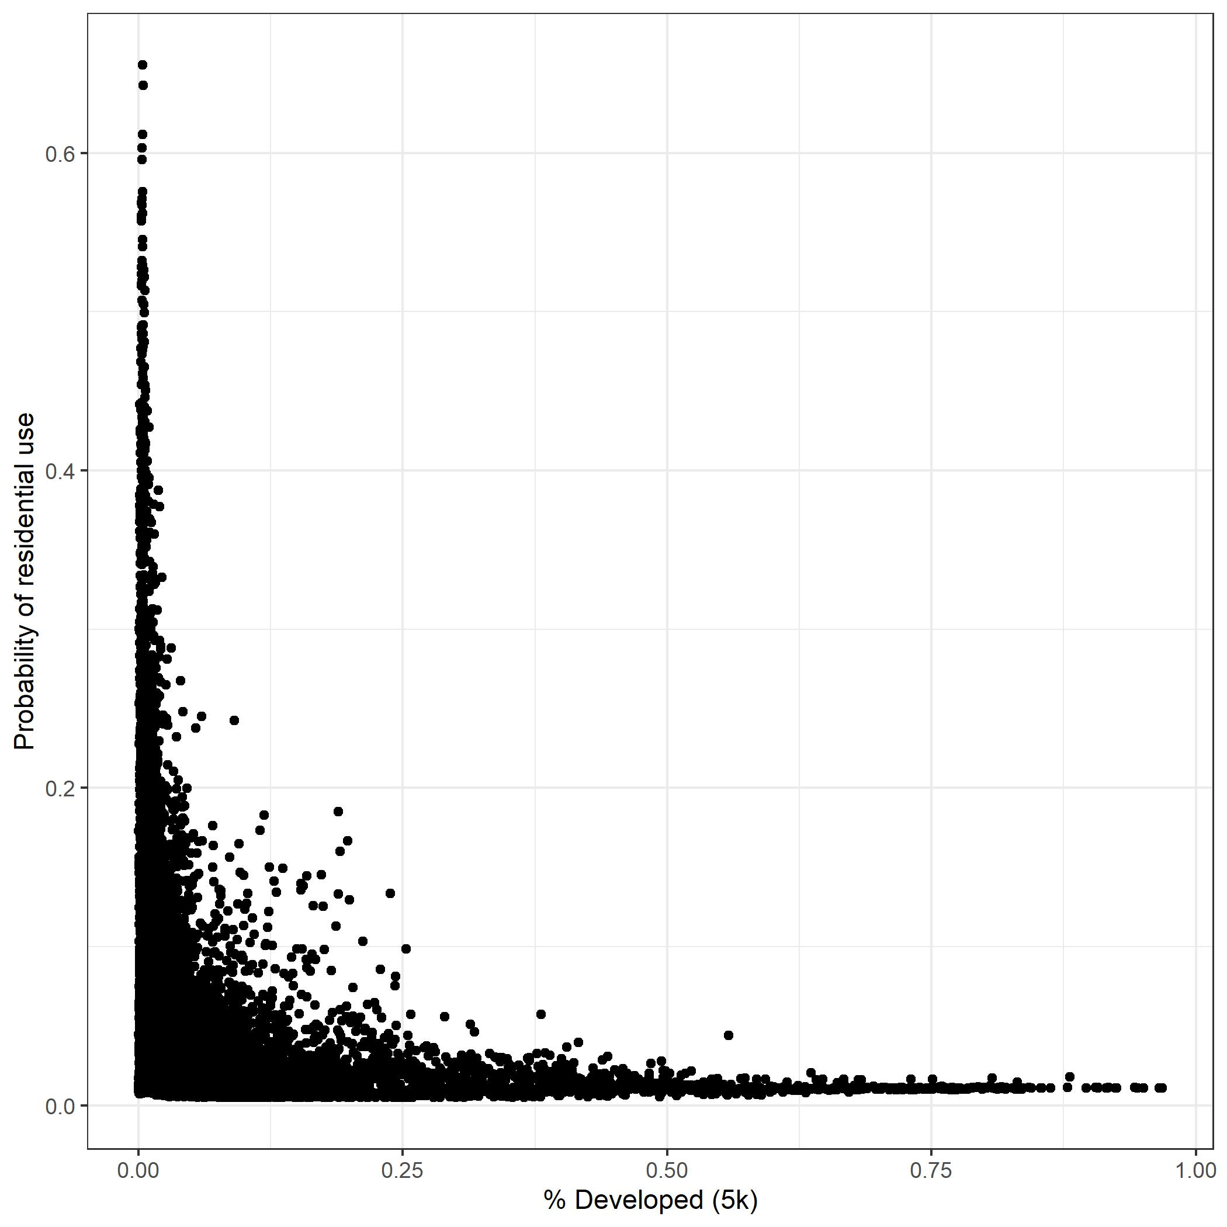
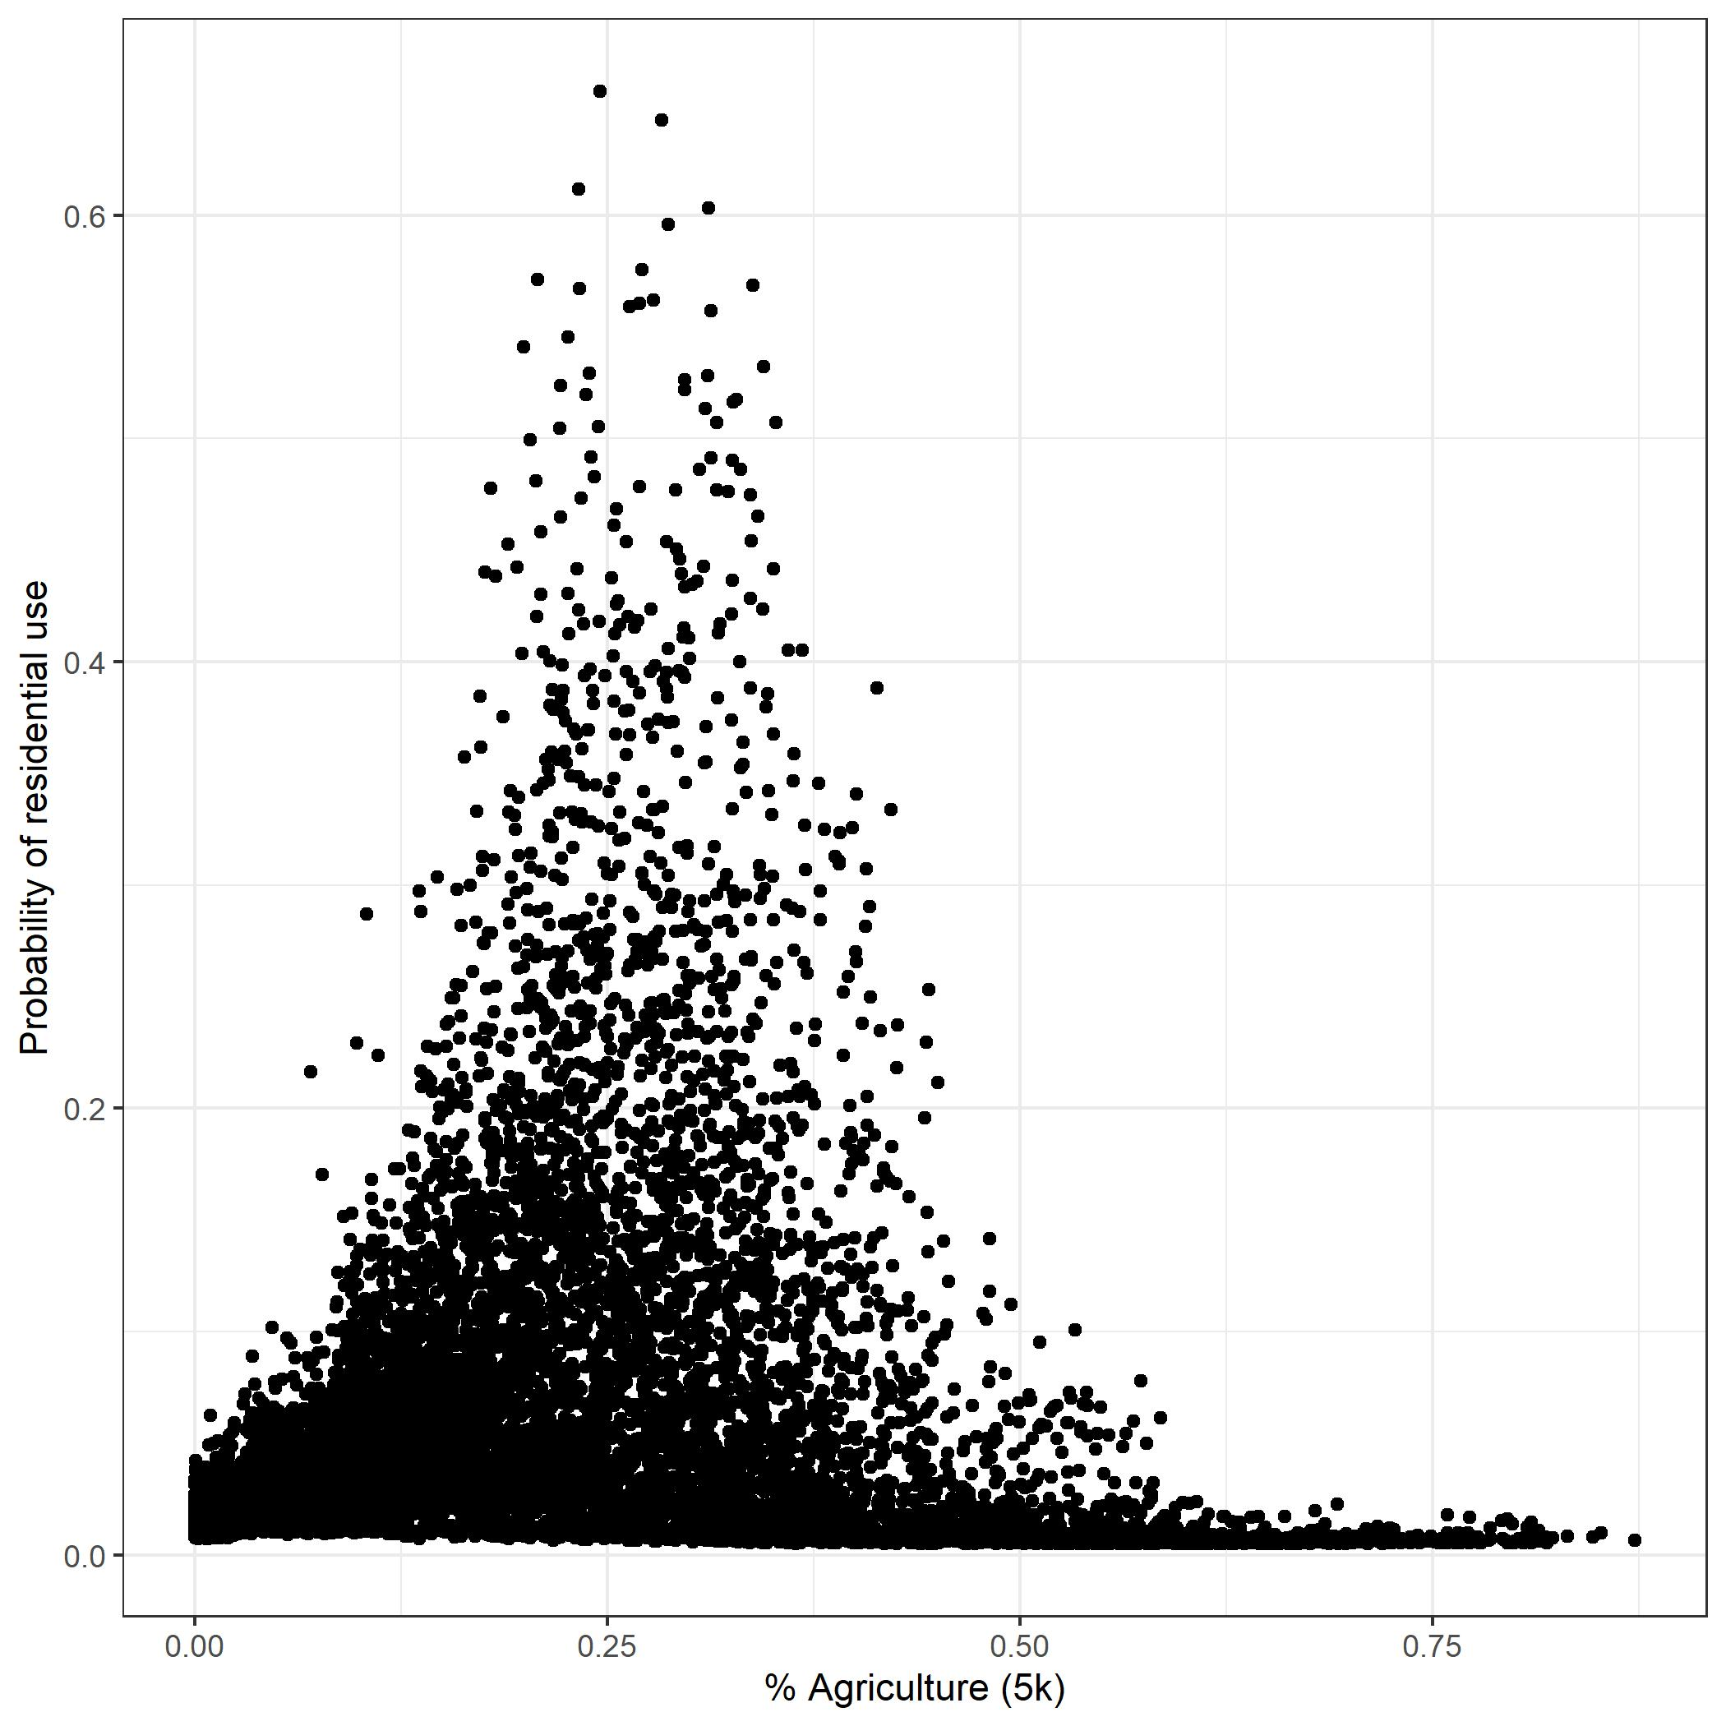
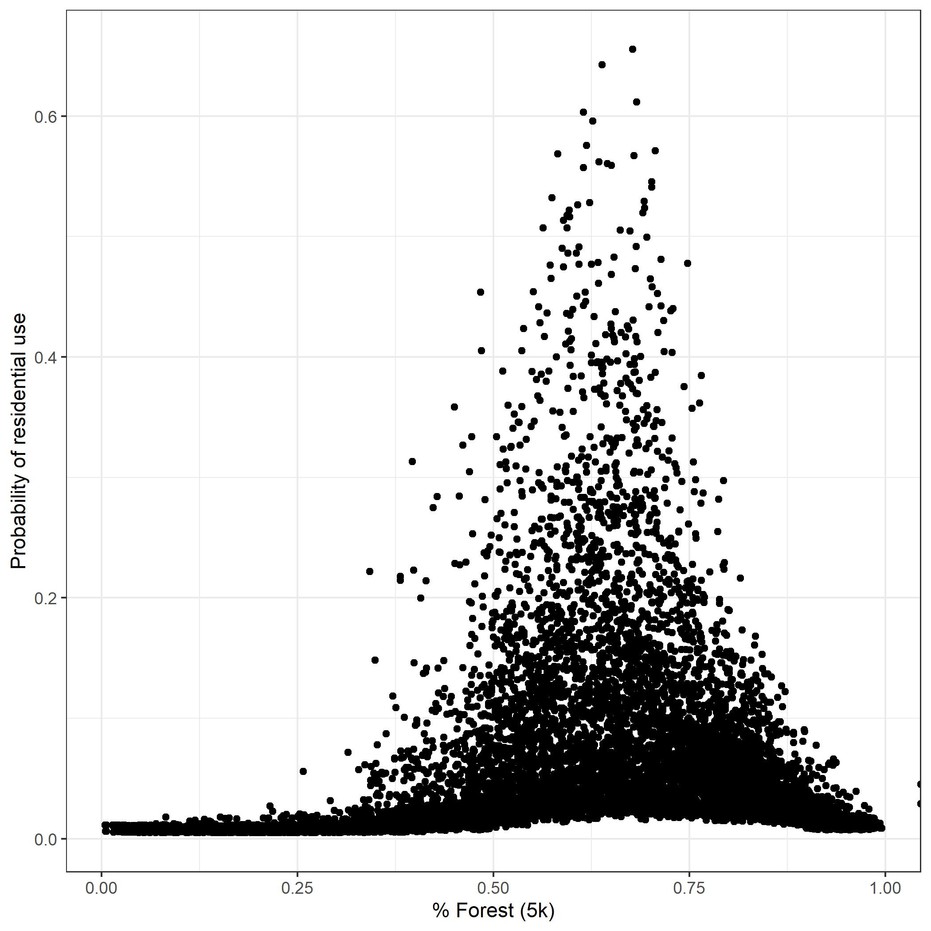
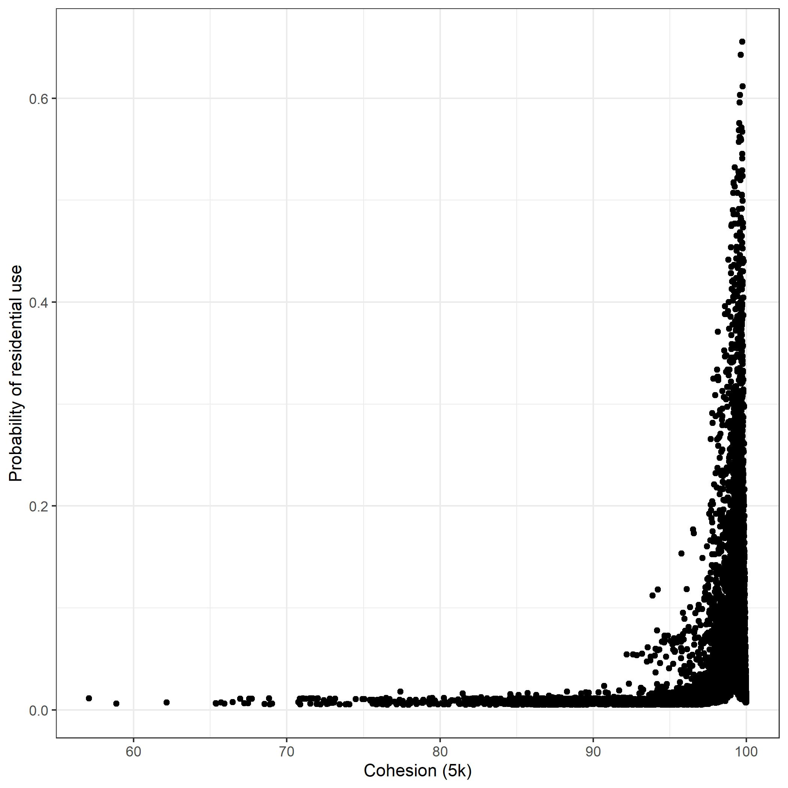

Slide 11
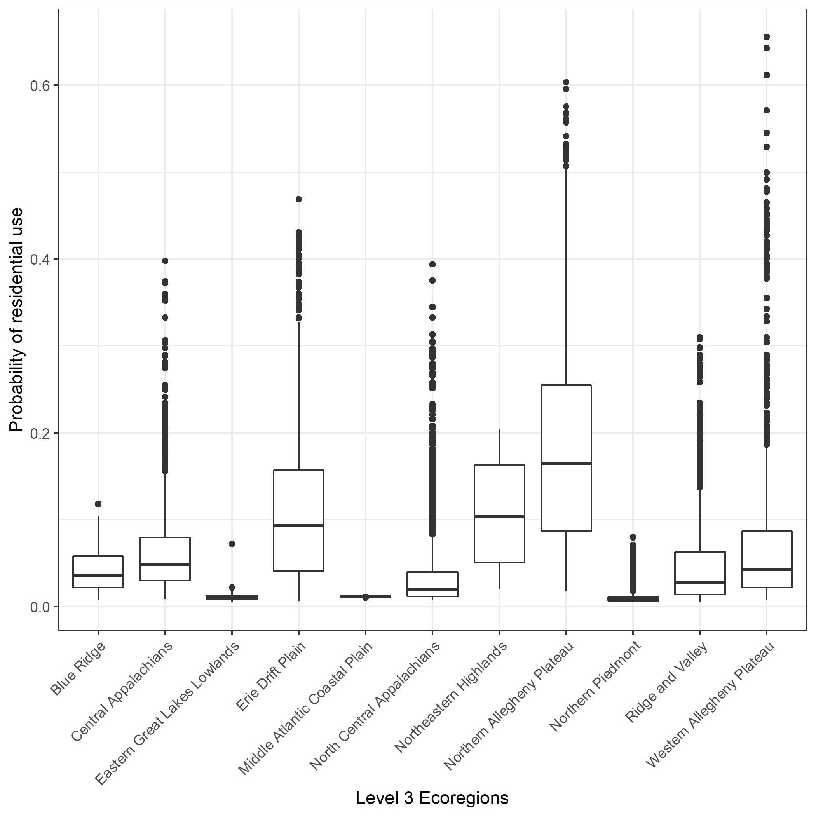

Slide 12
Shiny application
woodcock.shinyapps.io/woodcock_weighted_habitat/

Slide 13
Next steps timeline
July 2021
Beta versions of products complete
Feedback on Shiny app to be incorporated into the final product
By the end of July
Final shiny app/geodatabase
Mode of distribution?
Final report
Journal submission

Slide 14
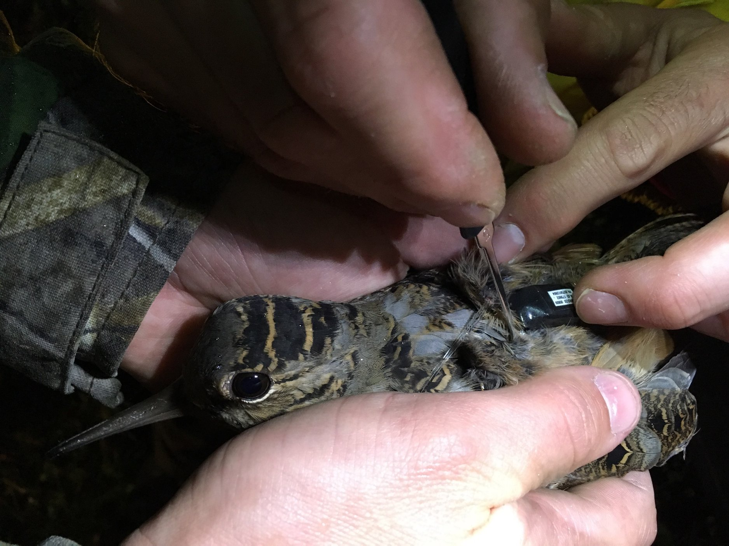
Wrap-up

Slide 15
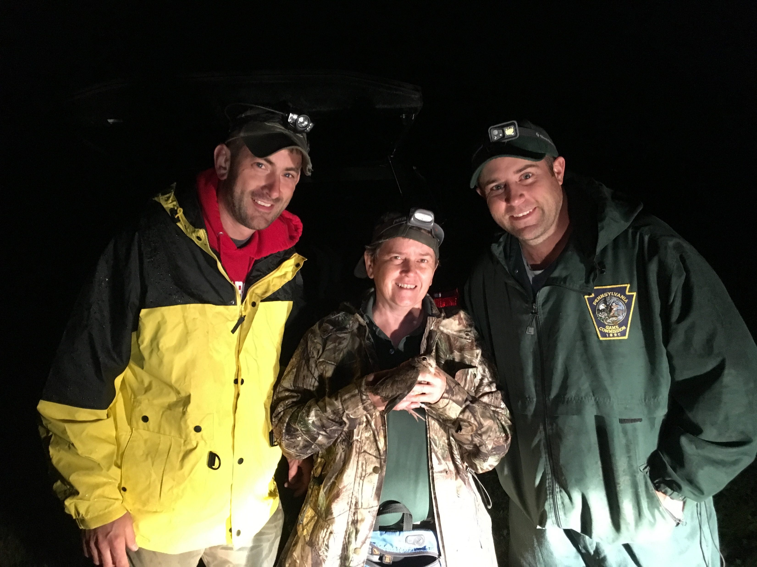
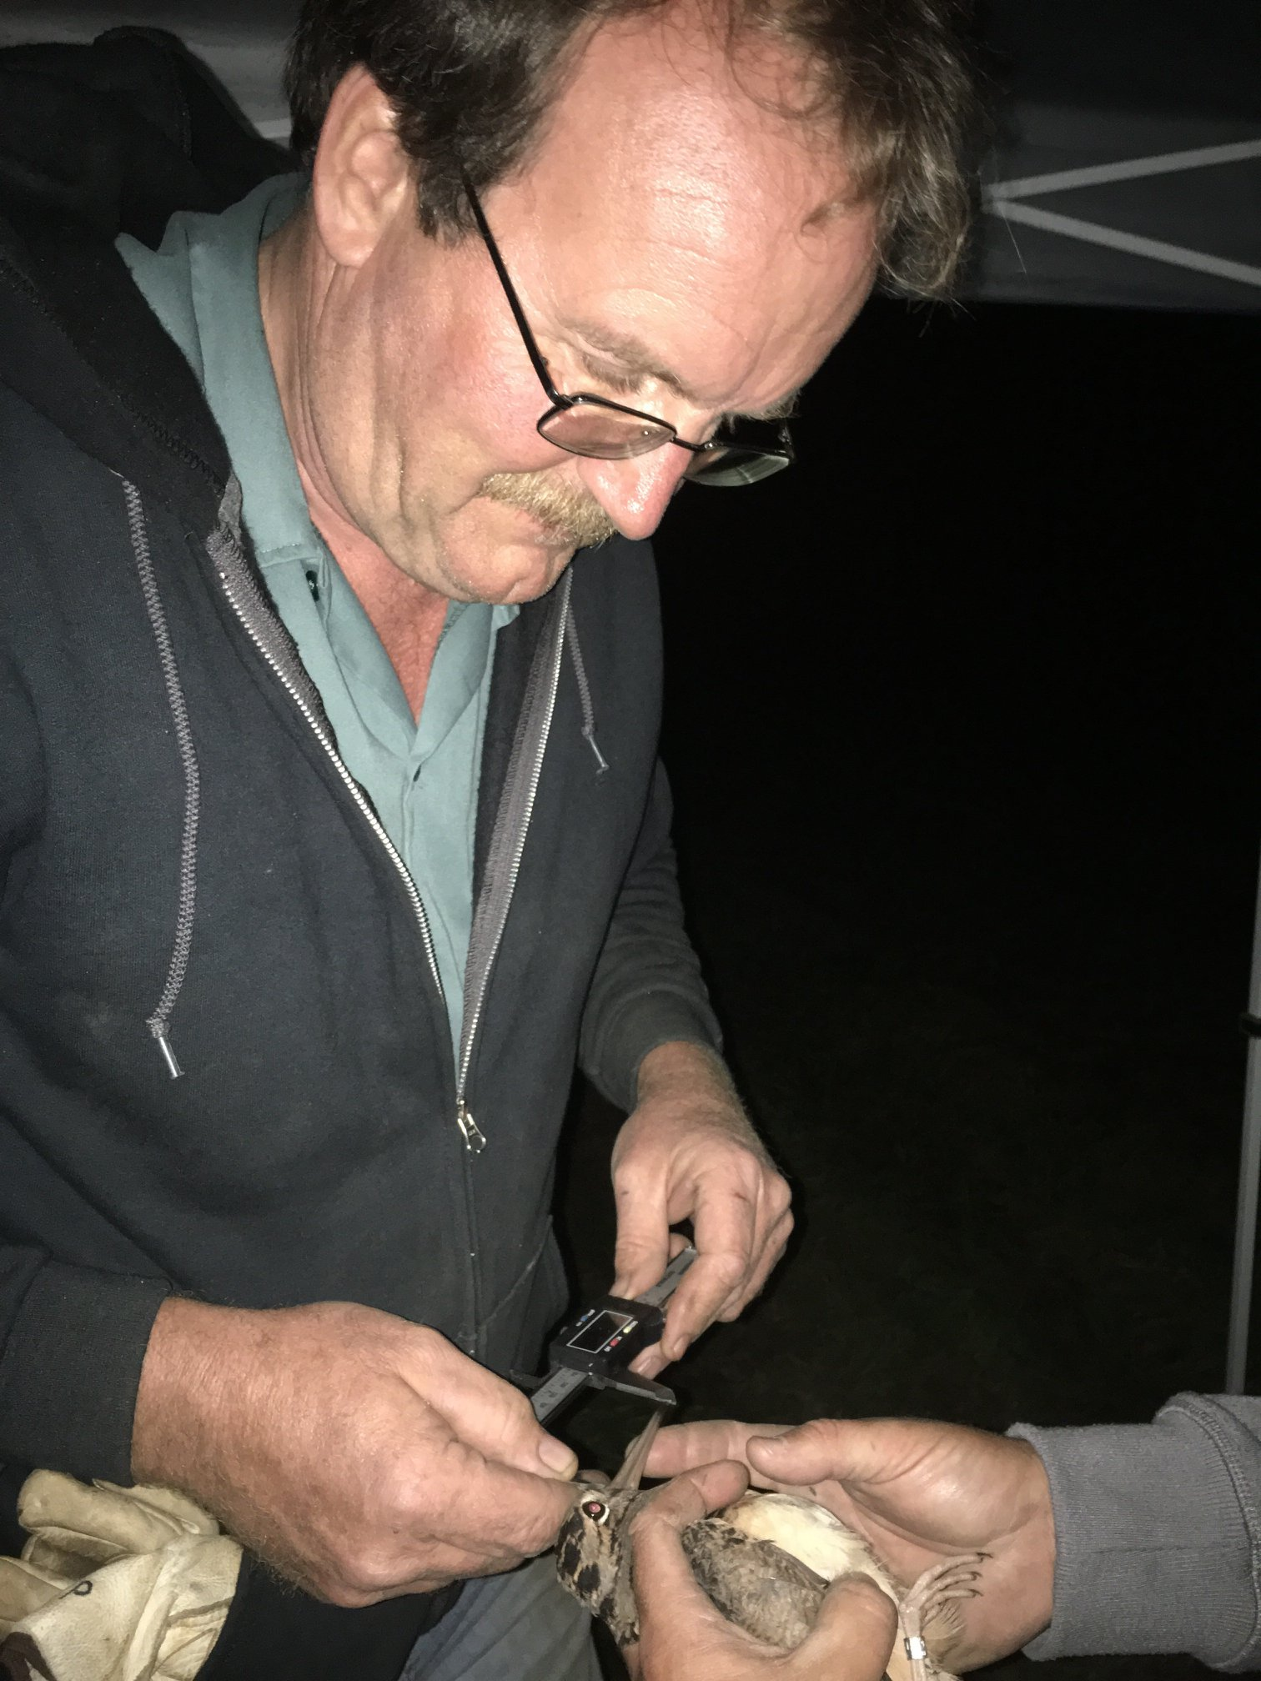
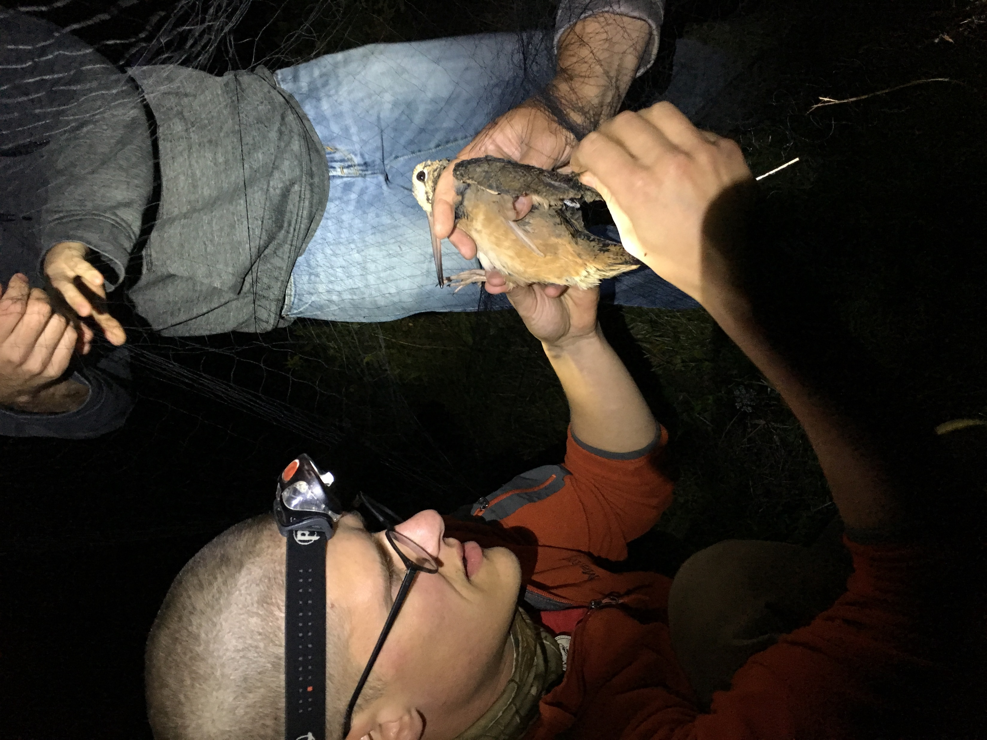
Thank you!

